Slide 1
UNHCR-PSP Italy – DRM
Accounts vs Contacts
Date 22/09/2020
Version 1.0

Slide 2
SUMMARY
1. Main Scenario
1.1 Additional Scenario
2.1 Recurring Donations from Accounts
2.2 Primary Affiliations
2.3 Contact Organization
3. Use Cases
Face2Face
Website
TMK / Email / Direct Mailing
Tax Mailing / Newsletter
4. Open Points

Slide 3
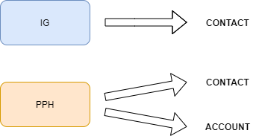
1 - MAIN SCENARIO
The general scenario is made up as follows:
IG Donors (typically Donor Type = 08-09), who have recurring donations and receive mass communications
PPH Donors (typically Donor Type = 51-58), who have single donations and receive one to one communications
They have been mapped on Salesforce as follows, according also to Unicorn’s data model:
IG Donors on Contact
PPH Donors on Contact
PPH Organizations on Account

Slide 4
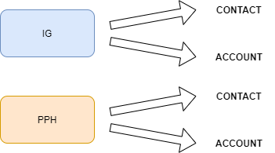
1.1 - ADDITIONAL SCENARIO
%j
Two additional requirements have been added, in particular UNHCR needs to:
Treat some IG Donors as Accounts: it is the case in which they have a company name («Ragione Sociale»), a personal name (when available) and the donations are made using the company’s tax code. Their Donor Type is in the IG range.
Be able to mass-communicate with Accounts, in particular for the case above described, but also for the others.
The result is that we have to add IG Accounts to the data model, as in the picture below.
Three additional developments are needed:
Add the possibility to create Recurring Donations from Accounts.
Identify one (or more) Contact(s), affiliated to an Account, who will be the recipient(s) of the mass communications.
Find a solution for all the cases in which there is only a company name («Ragione Sociale») for an IG Account, therefore there is no proper contact to send communications to.

Slide 5
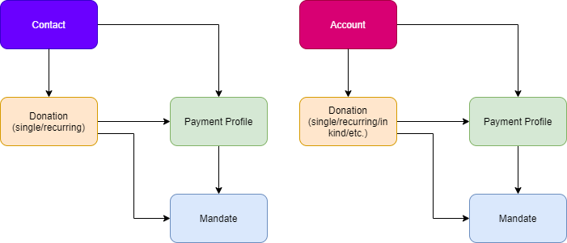
2.1 - CREATE RECURRING DONATIONS FROM ACCOUNTS
%j
Salesforce’s NonProfit Success Pack («NPSP») provides a data model that allows to make Recurring Donations from Accounts.
Our development is to create Quick Action Buttons to make Single and Recurring Donations from Accounts, duplicating the ones already availabe on Contact.
The data model will be exactly the same: both the Contact and the Account will be linked to the donations (single or recurring) and to the Payment Profile (and Mandate, in case of Recurring Donations), as in figure.
We also cloned on Accounts all segmentation rules used for Contacts, since they are based on donations, so that – for example - an IG Account who has an active recurring donation will have Donor Type = 09

Slide 6
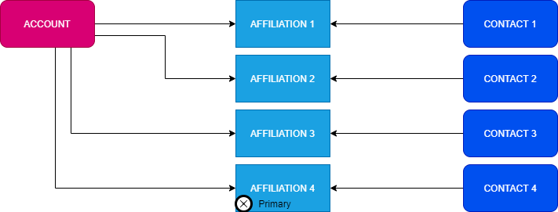
2.2.a - AFFILIATED CONTACTS AND PRIMARY AFFILIATIONS
%j
Salesforce’s standard data model does not allow to add Accounts to Campaigns, only Contacts. In order to have a Contact, related to an Account, that will be the recipient of the mass communications, we used Salesforce NPSP’s Affiliation.
An Affiliation is a relationship between a Contact and an Account. One (or more) Contact(s) can be Primary Affiliation(s), which means that they easily extracted as the target of the mass-communications. We suggest to use one Primary Affiliation for each Account.
If a Contact is no longer an Affiliation to an Account, it must be set as «Former» so to keep all the information related to him (campaigns, web events, etc.), it doesn’t have to bel deleted as Affiliation.
Additional fields can be added/used in order to give flexibility on extracting recipients for different types of communications.
For example, the Fiscal Recap flag will mark the affiliation contact that will receive it, be it primary or not).

Slide 7
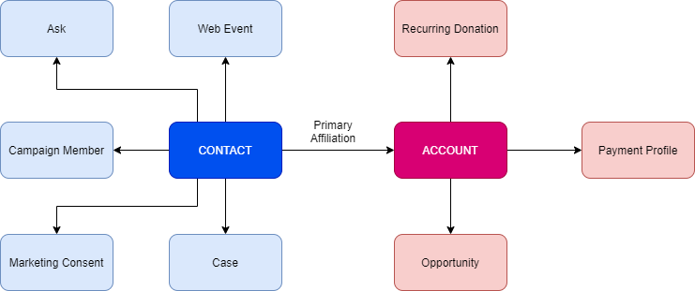
2.2.b - IG ACCOUNTS DATA MODEL
%j
While on the as-is system the IG Accounts are on a single table, on Salesforce they must be split on two Objects:
- Account will have all the donations- and payments-related information
- Contact (the Primary Affiliation) will have the contact information and personal preferences, such as Marketing Consents, Cases, Asks, etc.
Segmentation rules are calculated on the Account (because they are based on donations) but, using the Primary Affiliation, they can be displayed on the Contact.
We used formula fields so that, wheter the Contact is a donor or a Primary Affiliation, the fields to be extracted will always be the same.
(continues)

Slide 8
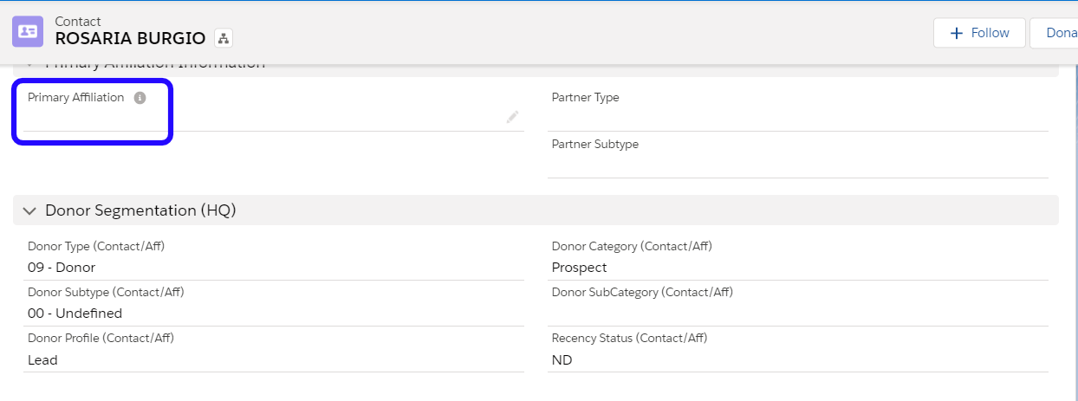
2.2.c - CONTACTS’ DUAL USAGE / 1
%j
This Contact is a Donor, he has no Primary Affiliations, so the Donor Segmentation fields will show the information based on his own donations

Slide 9
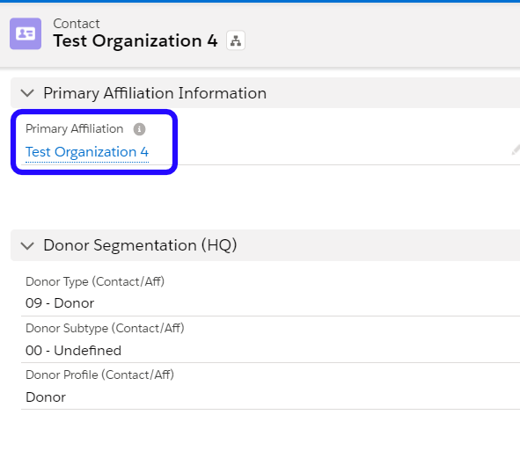
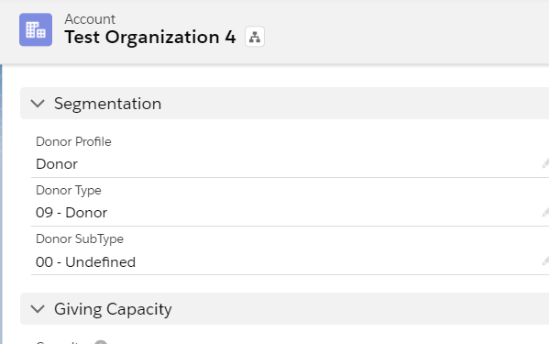
2.2.c - CONTACTS’ DUAL USAGE / 2
%j
This Contact is a Primary Affiliations, so the Donor Segmentation fields will show the information based on the Account’s donations. It is suggested to use a specific Donor Type for the Affiliated Contacts that are not donors.

Slide 10
2.2.d - PRIMARY AFFILIATION CHANGE
%j
It is possible that, in the course of time, the Primary Affiliation has to be changed. We will introduce a button that allows easily to change the Primary Affiliation (among the other Affiliations) that will also:
Move the Primary Affiliation flag to the new one
Move the Cases/Asks (all or some selected ones) to the new affiliation, because they are used to evaulate KPI’s
Copy some field values from the old Contact to the new (to be defined).
The new Primary Affiliation must have no individual donations in order to be selected. Otherwise, it has to be cloned and used as Affiliation only.
We suggest that Web Events, Campaign Member and Marketing Consents will stay on the old Contact, so to identify easily, for example, which Contact got a particular email.
A new component on Account will gather data from all Affiliations, meaning – for example – that it will be possible to see all the Campaigns for that Account.

Slide 11
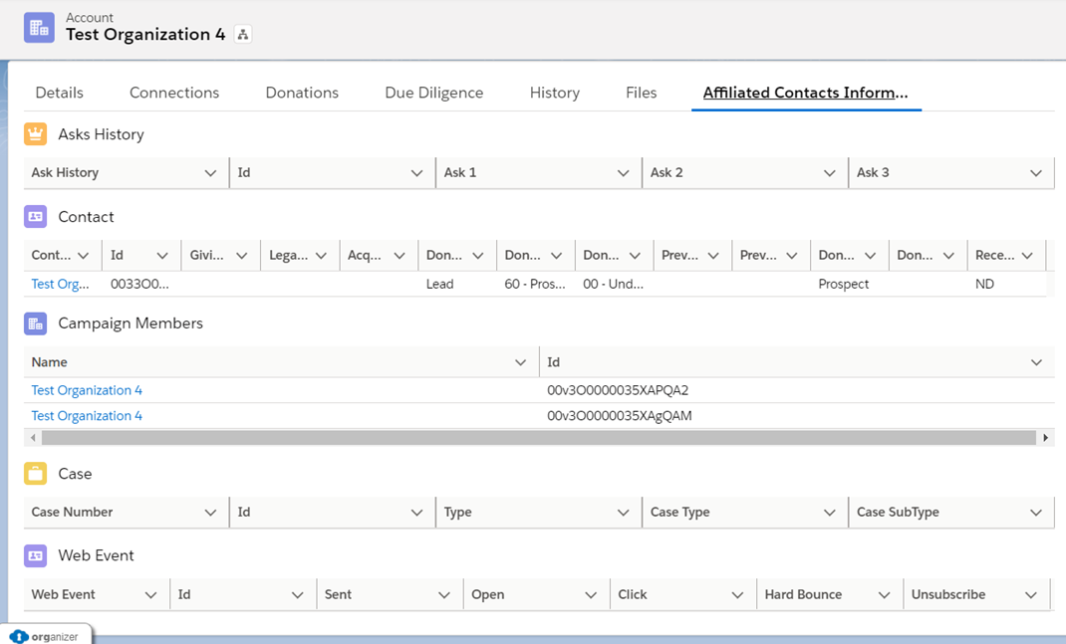
2.2.e - ACCOUNT AGGREGATED DATA
%j
All information regarding the records related to the Affiliation Contact are gathered on the Account in the Affiliated Contact Information tab. Below is a sample. Fields to be displayed for each object have to be defined.

Slide 12
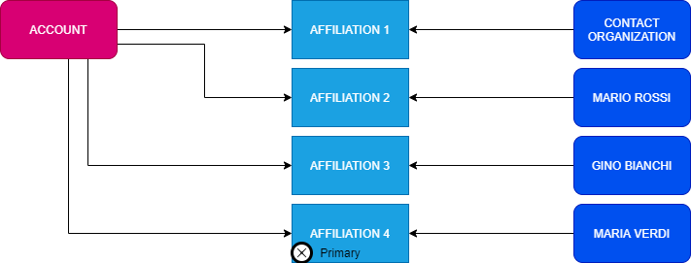
2.3 CONTACT ORGANIZATION
%j
For some of the IG Accounts, there is no personal contact available, meaning that there is only a company name and email address.
In order to avoid having no Contacts for an Account, we introduced the Contact Organization: every time an Account (Record Type = PPH Organization) is created, a new Contact is created afterwards, copying all Account information on it and setting Gender = Organization. By default, it is set as Primary Affiliation.
The Contact Organization is always created for each new Account, both during the migration process and after the go-live.
In particular for the migration, we set it as Primary Affiliation only when there is no personal Contact available.

Slide 13
3 - USE CASES
%j
FACE TO FACE
WEBSITE
TMK/EMAIL/DIRECT MAILING
TAX MAILING/NEWSLETTER

Slide 14
3.1 FACE TO FACE
%j
No change will be made to the current Face2Face processes: only Contacts will be created, since the current batch file only has an additional field («Ragione Sociale») and it is not enough to have the required data.

Slide 15
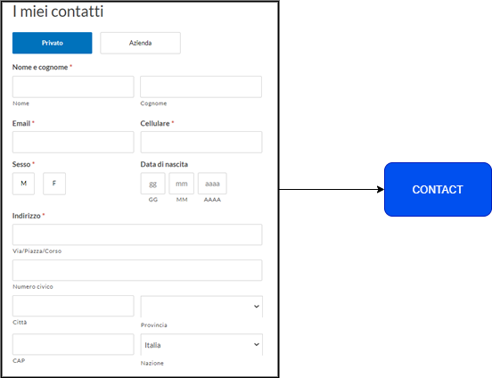
3.2 WEBSITE / 1
%j
Two different flows will be available, based on the current possible selections: individual donor and company.
An individual donor will always be mapped onto a Contact.

Slide 16
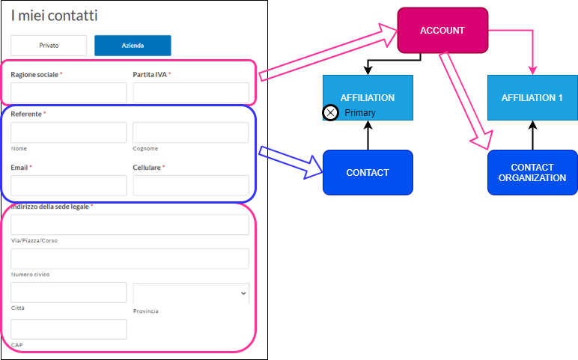
3.2 WEBSITE / 2
%j
A donation made by a company will be mapped as follows:
Sections in pink will be mapped onto Account, and will be subsequently copied onto the Contact Organization (automatically created).
Sections in blue will be mapped onto the personal Contact which will be created as well, and will be flagged as Primary Contact.
All donation and payment information will be linked to the Account.

Slide 17
3.2 WEBSITE / 3
%j
OPEN POINTS:
It has to be decided what to do in case a donor who already has a recurring donation through an Account makes a donation from the website as an individual, since it’s not possible to have a Contact who is at the same time a Primary Affiliation AND a donor. In this case, the Contact has to be cloned, so that one will have its own segmentation as a donor and the other its Account’s segmentation.
A possible scenario is a warning that tells the user that he already has a donation as an Account, so he can proceed either making a one off linked to his Account, or create a new Contact to be used as Donor (being the existing one a Primary Affiliation).

Slide 18
3.3 TMK/EMAIL/DIRECT MAILING
%j
All extractions will be made on Contacts, as they are added to Campaigns.
Flexibility is available, since there are lots of fields to be used as filters, not only the Primary Affiliations
All return flows will be redirected:
On the Contact, if a Case is created or if the address or the marketing consents are modified.
On the Account, if the variation is related to donations and payment methods.

Slide 19
3.4 TAX MAILING/NEWSLETTER
%j
Multiple flags are available on Contact, making easy to filter specific Affiliations (not necessarily the primary) for different purposes.
For example:
Newsletter flag
Tax Mailing flag

Slide 20
4 OPEN POINTS
%j
This is a brief recap of the open points:
Primary Affiliation change: what fields/objects have to be copied/moved onto the new Primary Affiliation.
Website: if an existing Primary Affiliation wants to do an individual donation.
Tax Mailing recipient (PPH in particular).
Accounts on F2F: how to handle the data on the current excel file.
IG Accounts migration: hybrid cases with donations related to Accounts and payments to the Contact.

